Slide 1
Project Management: Part 1

Slide 2
Why care about project management?
  10% of projects were successful between 1998 and 2004

Slide 3
Project Management – 4 Ps
People — the most important element of a successful project
Product — the software to be built
Process — the set of framework activities and software engineering tasks to get the job done
Project — all work required to make the product a reality

Slide 4
Software Teams
What are the factors to consider while selecting a team?
the difficulty of the problem to be solved
the size of the resultant program(s) in lines of code or function points
the time that the team will stay together (team lifetime)
the degree to which the problem can be modularized
the required quality and reliability of the system to be built
the rigidity of the delivery date
the degree of sociability (communication) required for the project
Notes:
You are the team leader

Slide 5
Organizational Paradigms
Closed paradigm—structures a team along a traditional hierarchy of authority
Open paradigm—attempts to structure a team in a manner that achieves some of the controls associated with the closed paradigm but also much of the innovation that occurs when using the random paradigm
Synchronous paradigm—relies on the natural compartmentalization of a problem and organizes team members to work on pieces of the problem with little active communication among themselves
Random paradigm—structures a team loosely and depends on individual initiative of the team members
Notes:
You are the team leader

Slide 6
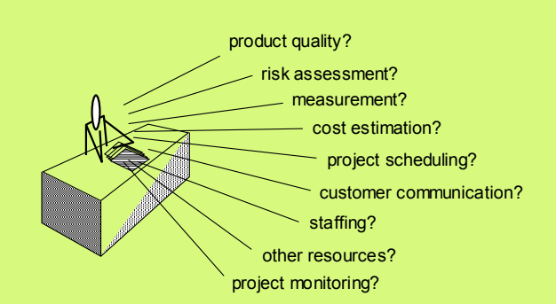
Project Management Concerns
Notes:
You are the team leader

Slide 7
Project Management – 4 Ps
People
Product
Process
Project

Slide 8
Stakeholders are people too
Senior managers who define the business issues that often have a significant influence on the project.
Project (technical) managers who must plan, motivate, organize, and control the practitioners who do software work.
Practitioners who deliver the technical skills that are necessary to engineer a product or application; often make poor team leaders
Customers who specify the requirements for the software to be engineered and other stakeholders who have a peripheral interest in the outcome.
End-users who interact with the software once it is released for production use.
Your job is to organize and bring value from these people
Notes:
You are the team leader

Slide 9
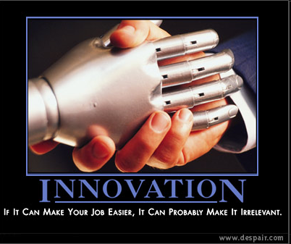
Your job as a leader
The MOI Model
  Motivation. The ability to
  encourage (by “push or pull”)
  technical people to produce to their best ability.
  Organization. The ability to mold existing processes (or invent new ones) that will enable the initial concept to be translated into a final product.
  Ideas or innovation. The ability to encourage people to create and feel creative even when they must work within bounds established for a particular software product or application.
Notes:
Pushing uses the stick, pulling uses the carrot…carrot is better, but the stick is sometimes required
Basis is problem solving

Slide 10
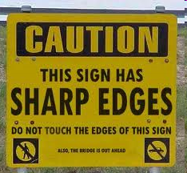
Your job as a manager
Make sure these happen
Formal risk management
Empirical cost and schedule estimation
Metrics-based project management
  Tracking – amount of work done, costs, work remaining, etc…
Defect tracking against quality targets
People-aware project management

Slide 11
Project Manager
Management is using tools and techniques
Leadership is inspiring people to do the right thing
Leadership with poor management practices can be successful, management with poor leadership will fail.

Slide 12
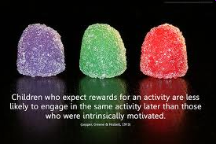
Motivating People
Use monetary rewards cautiously
Use intrinsic rewards
  Recognition
  Achievement
  The work itself
  Responsibility
  Advancement
  Chance to learn new skills

Slide 13
Understanding the problem
At the beginning you should ask yourself these questions
Why is the system being developed?
What will be done?
When will it be accomplished?
Who is responsible?
Where are they organizationally located?
How will the job be done technically and managerially?
How much of each resource (e.g., people, software, tools, database) will be needed?

Slide 14
Defining the problem
Establish Scope: A narrative that establishes the boundary of the problem
Decomposition: Establishes Functional Partitioning

Slide 15
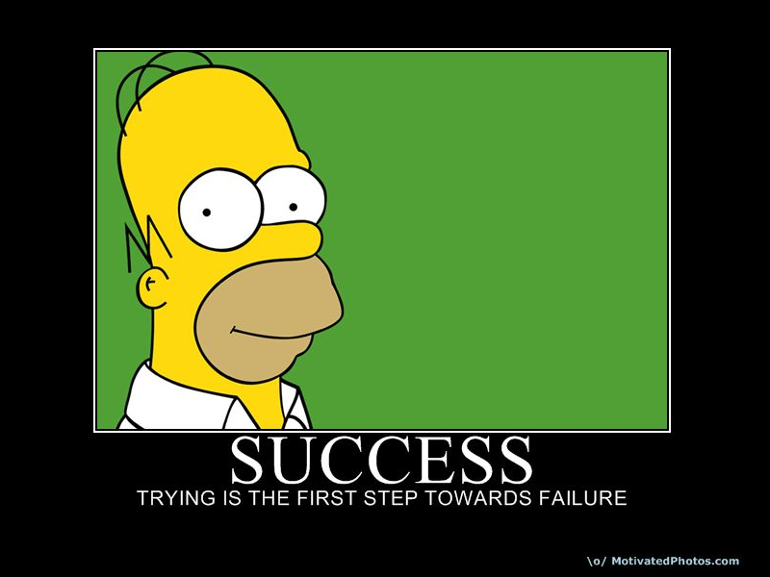
Define success and failure
Don’t lie to yourself!
Be confident, trust
yourself for success!
Quantify your project
outcomes to allow
success or failure
A vague or un-measurable outcome is much less helpful
Notes:
Bad goal: we’re going to improve communication across the company
Good goal: we’re going to take a survey of people’s views of communication across the company and increase overall satisfaction by 25%.

Slide 16
Leadership Case Study: 3M
Philosophy:
As our business grows, it becomes increasingly necessary to delegate responsibility and to encourage men and women to exercise their initiative. This requires considerable tolerance. Those men and women to whom we delegate authority and responsibility, if they are good people, are going to want to do their jobs in their own way.
"Mistakes will be made. But if a person is essentially right, the mistakes he or she makes are not as serious in the long run as the mistakes management will make if it undertakes to tell those in authority exactly how they must do their jobs.”
"Management that is destructively critical when mistakes are made kills initiative. And it's essential that we have many people with initiative if we are to continue to grow." .
These are common themes now, but not in 1940s when 3M codified them

Slide 17
3M Results
Encouragement and a culture of innovation yields:
1968 Dr. Spence Silver does an experiment that yields an adhesive that sticks, but not strongly
Presents around the company for 5 years with no “takers”
In 1973, 3M scientist Art Fry was trying to mark his place in his church choir hymn book with bits of paper that kept falling out.
Art works with Spence. Creates little notepapers.
Marketing says “not enough market, who wants to pay for scraps of paper?”, engineering says “too hard to make, will be costly”
Response: If it’s hard to make that’s great, no one but 3M will be able to do it!
Fry sends out “free samples” across the company, making sure to include executive’s assistants
Demand rises – finally the product is introduced. Within 1 year PostIt notes named “Outstanding New Product” and today generates $100 million in US sales
This is possible because of a culture in the company to empower, encourage, and experiment!

Slide 18
Software Projects
Factors that influence the end result:
Size
Delivery Deadline
Budgets and Costs
Application Domain
Technology to be implemented
System Constraints
User Requirements
Available Resources

Slide 19
Why do Projects Fail?
Changing customer requirements
Unrealistic project deadline
Underestimation of effort required
Predictable or unpredictable risks
Technical difficulties
Miscommunication among project staff
Failure in project management

Slide 20
How to reduce Project Failure?
We can start by finding the answers to the following questions:
Why is the system being developed?
What will be done? By when?
Who is responsible for a function?
Where are they organizationally located?
How will the job be done technically and managerially?
How much of each resource (e.g., people, software, tools, database) will be needed?

Slide 21
Critical Practices
Formal risk analysis
Empirical cost and schedule estimation
Metric-based project management
Earned value tracking
Defect tracking against quality targets
People-aware project management

